Slide 1
NAME:KALAIYARASI.P
COLLEGE CODE:6202
REG No:62021104012

Slide 2
Building bus reservation system

Slide 3
ABSTRACT
Online Bus Ticket Reservation System is a Web based application that works within a centralized network. This project presents a review on the software program “Online Bus Ticket Reservation System” as should be used in a bus transportation system, a facility which is used to reserve seats, cancellation of reservation and different types of route enquiries used on securing quick reservations. OBTRS is built for managing and computerizing the traditional database, ticket booking and tracking bus and travel made. It maintains all customer details, bus details, reservation details.

Slide 4
PROBLEM STATEMENT
the population of the magnificent city of Lahore is rising and thenumber of passengers travelling in the buses increase and thepassengers usually do not have much time. The following problemshave been mentioned by the LTC:

Buses do not

Slide 5
PROJECT OVERVIEW
They just need internet and device to use our system. They can check the route, price, class, etc. They can pay the fare using a credit card, debit card, internet banking, online wallet like Paytm, and cash too. Managing buses, employees, and salaries would be very comfortable using this system. This is a safe and secure way to expand the business.

Slide 6
Technology VieW
.
Technology is an integral part of society – no one can escape it. Even though technology is such a common factor of everyone’s lives, it impacts individual’s lives differently. While some view the growth of technology as positive, others see the development of technology as a hinderance. As a result, businesses and organizations need to make sure the types of technology they use, along with when they use it, are aligned with their consumer base.

Slide 7
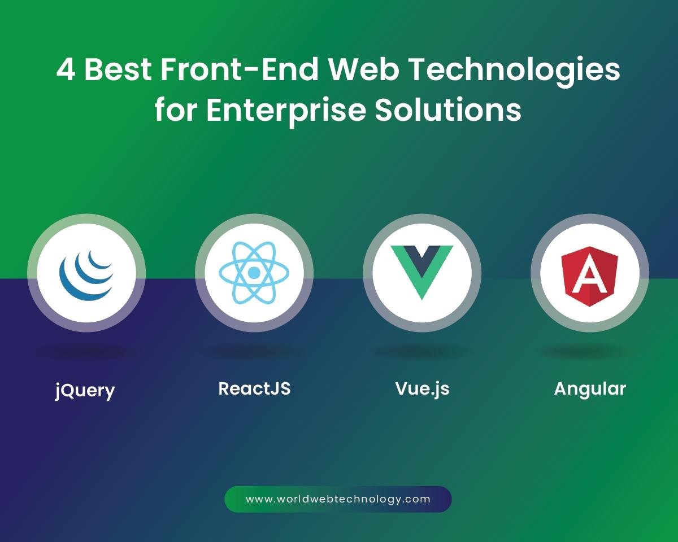

Slide 8
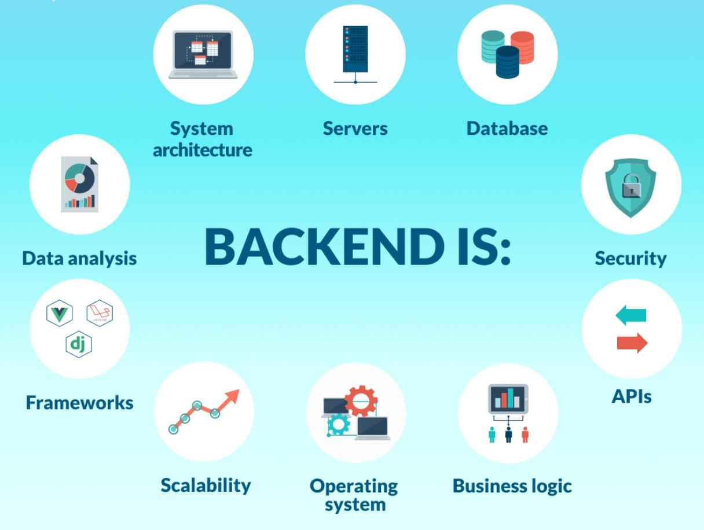
Technology is an integral part of society – no one can escape it. Even though technology is such a common factor of everyone’s lives, it impacts individual’s lives differently. While some view the growth of technology as positive, others see the development of technology as a hinderance. As a result, businesses and organizations need to make sure the types of technology they use, along with when they use it, are aligned with their consumer base.

Slide 9
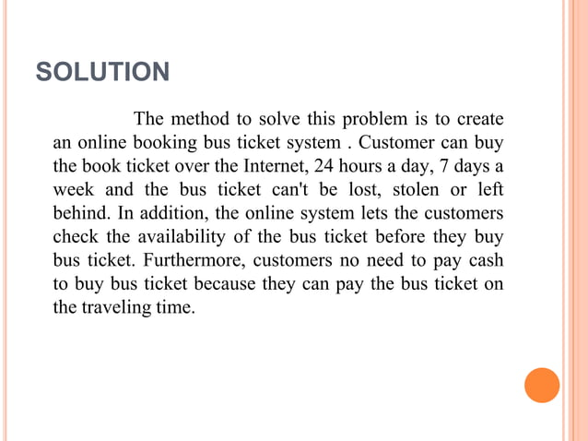
Modeling & Result
r

Slide 10
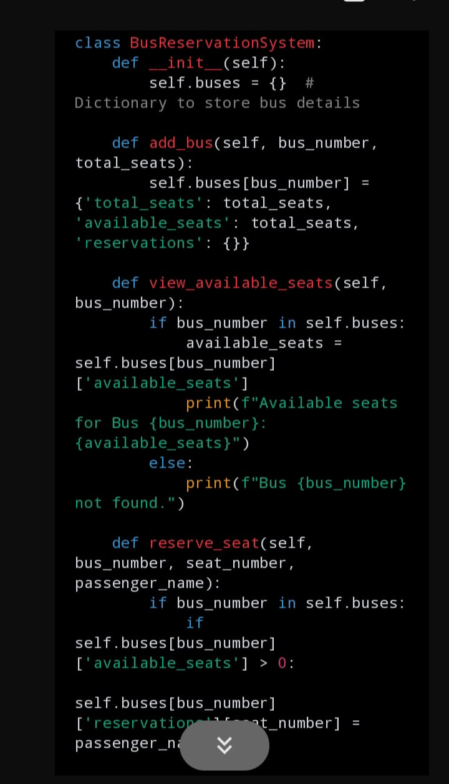
SCrEen ShoT
Leveraging years of research Mage Team created customized ticketing solutions for bus seat reservations. Accelerate your ticketing system with WP WpBusTicketly though have a small business or large. The Mage team has innovated a data-driven solution, simplifying ticket and reservation management for rental systems. Tackling the complexities, our invention ensures an easy and efficient approach to managing reservations, offering a streamlined solution to longstanding challenges.

Slide 11
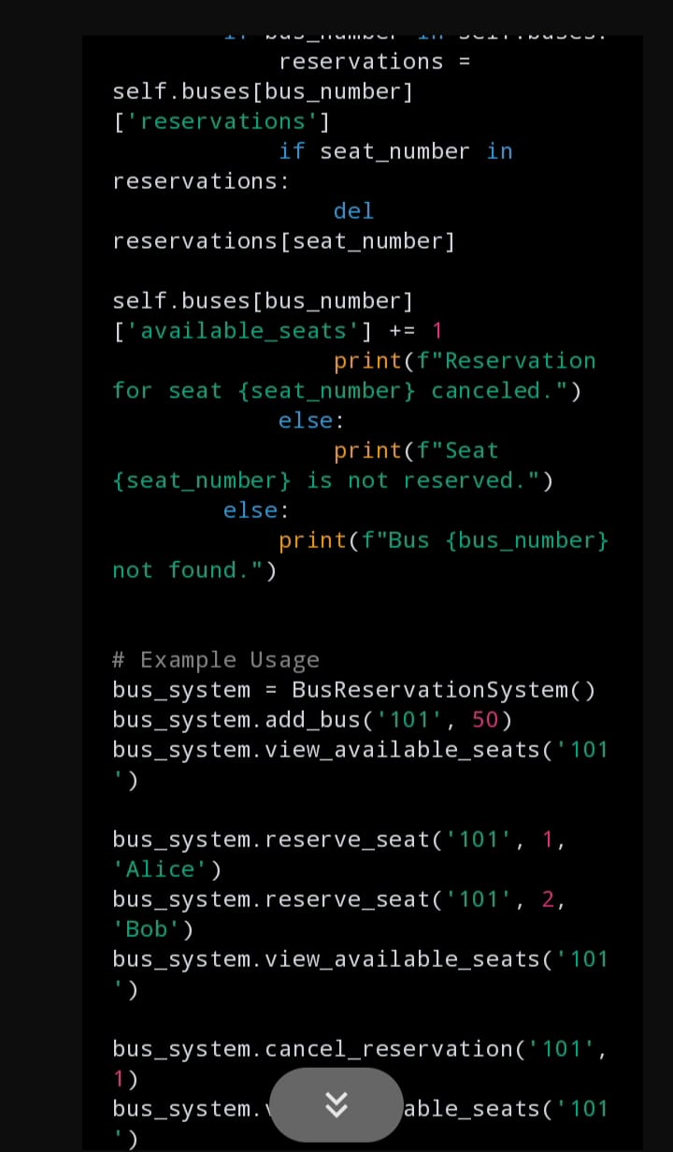

Slide 12
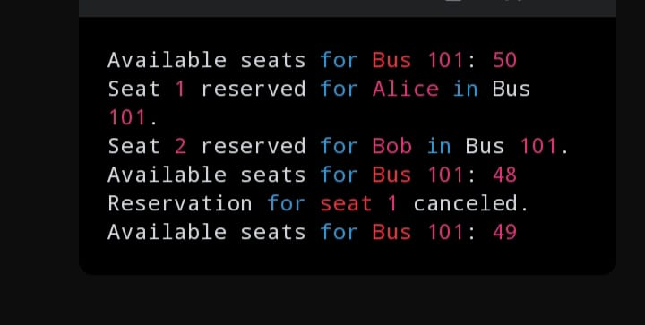

Slide 13
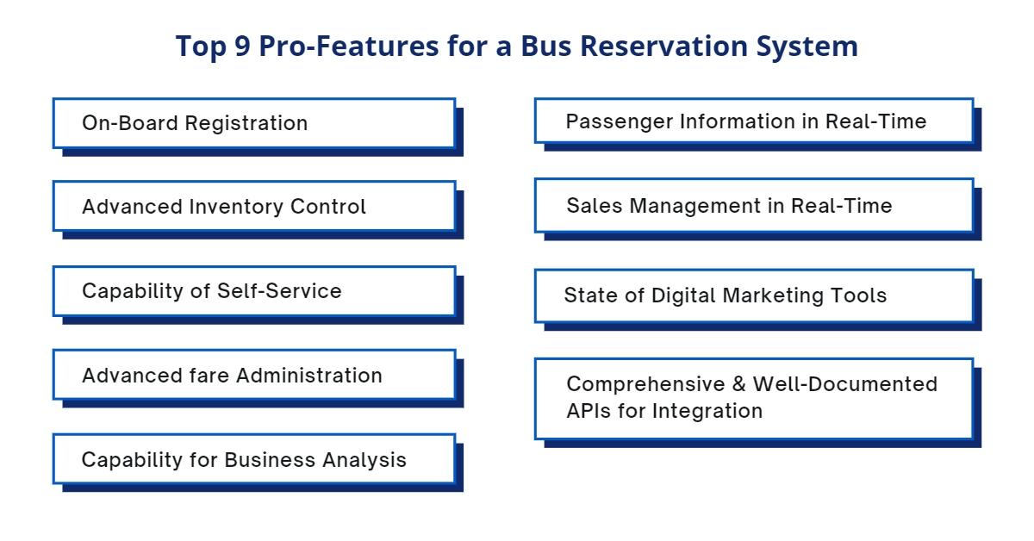
Future Enhancement

Slide 14
Conclusion
Online ticket booking system is an application where the customer can book a ticket online and 24*7 hours a day from anyplace in the world. Customers can also interact with the ticket booking website to know any other details they want. Online ticket booking system has been developed successfully. System performance is also found to be satisfactory. This is a user- friendly application. Through this application, the cost can be reduced and efficiency is increased. There are several procedures that can be selected by customers. With the help of this application customers can book tickets, can know the status of a flight, bus or trains, a Source station and destination can be chosen according to their choice, can select seats, can.

Slide 15
Thank You

